Slide 1
ELEMENTS OF FASHION PROCESS

Slide 2
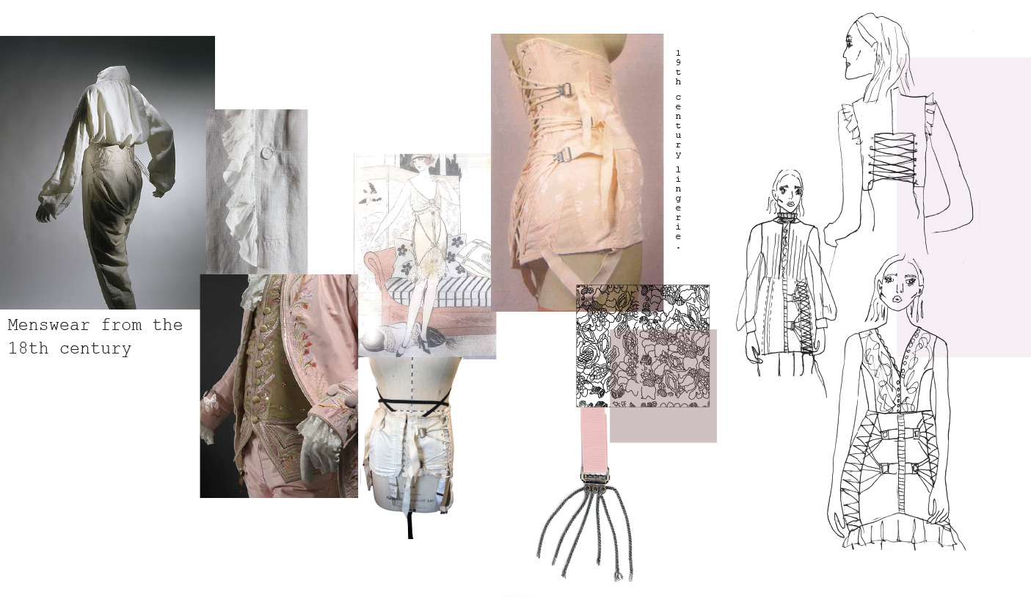
ELEMENTS OF FASHION PROCESS

Slide 3
FASHION ORIGIN
Day.1
designing can be loosely defined as 'the art of creating fashionable apparel'. The origin of fashion designing dates as far back as 1826. Charles Frederick Worth is believed to be the first fashion designer in the world, from 1826 to 1895. Charles, who was earlier a draper, set up a fashion house in Paris.
The history of fashion design and the development of the fashion industry began in the 19th century, when Charles Frederick Worth sewed his label into the garments he created. Before becoming successful, Charles Frederick was a draper in Paris.

Slide 4
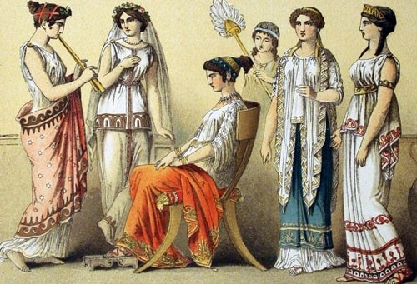
FASHION ORIGIN

Slide 5
FASHION EVOLUTION
Day.2
Over Seventy Years of Fashion History - How Fashions Have Changed Since the 1920s. ... From the 1920s to the 1990s, popular fashions reflected the mood of each decade and showcased changes in society as the styles of clothing and accessories evolved with the times.
Fashion designing has evolved into a full-fledged industry today. ... It was he who started the tradition of fashion houses and telling his customers what kind of clothing would suit them. During this period, a number of design houses began to hire the services of artists to develop patterns for garments.

Slide 6
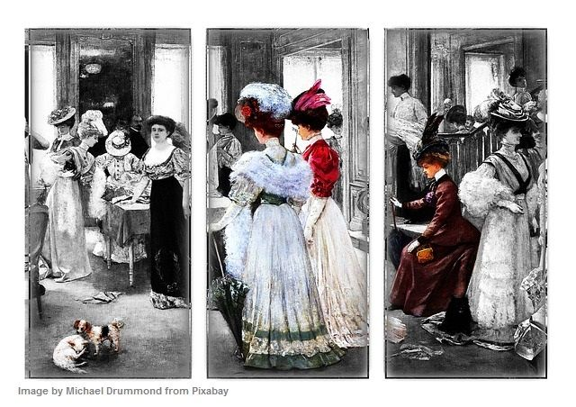
FASHION EVOLUTION

Slide 7
FASHION EVOLUTION IN INDIA
Day.3
The history of clothing in India dates back to ancient times, yet fashion is a new industry, as it was the traditional Indian clothing with regional variations, be it the sari, ghagra choli or dhoti, that remained popular until the early decades of post-independence India.

Slide 8
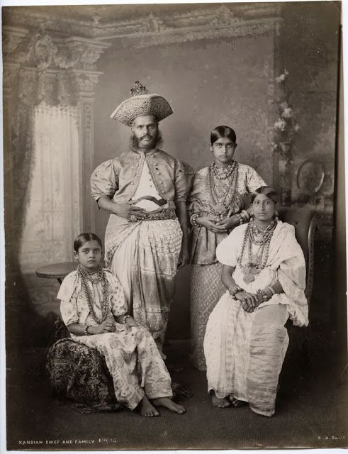
FASHION EVOLUTION IN INDIA
BRITISH RAJ:the advent of british raj in india encouraged the british cloth in india

Slide 9
FASHION CYCLES
Day.4
Fashion cycle – a period of time or life span during which the fashion exists, moving through the five stages from introduction through obsolescence. When a customer purchases and wears a certain style, that style is considered accepted. The acceptance leads to the style becoming a fashion
Conventional wisdom in the fashion industry declares that trends cycle every 20 years. This cycle, however, is now an imprecise and fairly useless measure of trends. Social media has placed a spotlight on fashion around the world, proving that styles from every decade now have a place in the average person's wardrobe.

Slide 10
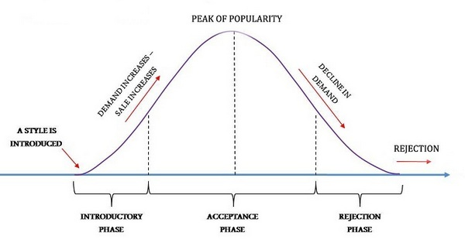
FASHION CYCLES
CLASSIFICATION
Day.5

Slide 11
FASHION CYCLES
CLASSIFICATION
Introduction
Rise in popularity
Peak of popularity
Decline in popularity
Rejection

Slide 12
FASHION THEORIES
Day.6
FASHION THEORIES
Theories of fashion adoption or distribution are concerned with how fashion moves through the various socioeconomic levels of society. There are three primary theories of fashion adoption: trickle-down, trickle-across and trickle-up.
Fashion theories indicates the process of fashion ideas. The theories explain the fashion trend. It also tells about how fashion moves from one stage to other stage

Slide 13
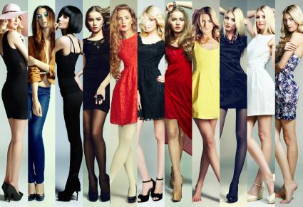
FASHION THEORIES

Slide 14
FASHION THEORIES
TRICKLE DOWN
TRICKLE UP
TRICKLE ACROSS

Slide 15
MAJOR FASHION SEASONS
Day.7
2 MAJOR FASHION SEASONS
Fashion is split into four seasons. These seasons are Spring/Summer, Fall/Winter, Resort and Pre-Fall. The two major seasons, however, are Spring/Summer and Fall/Winter. Spring/Summer starts in January and runs until around June, and Fall/Winter goes from July to December.

Slide 16
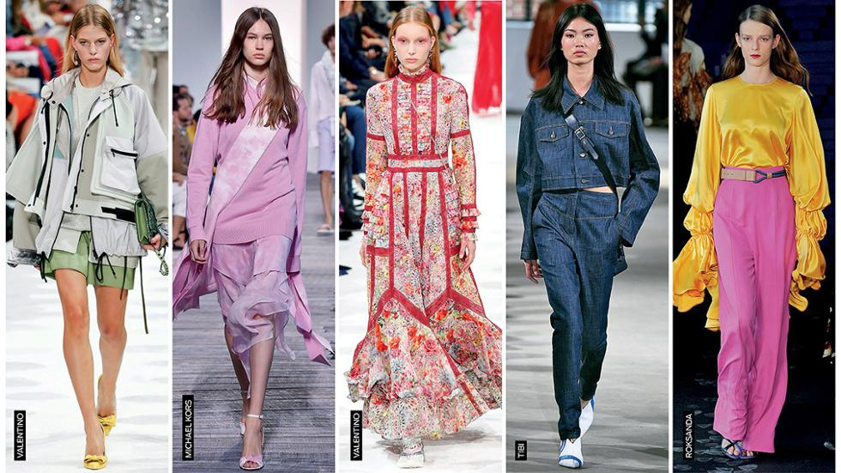
SPRING/SUMMER

Slide 17
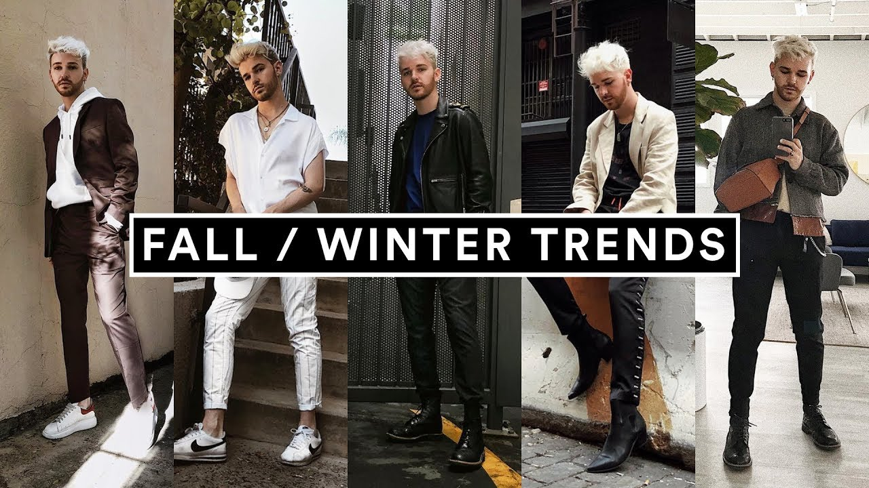
FALL/WINTER

Slide 18
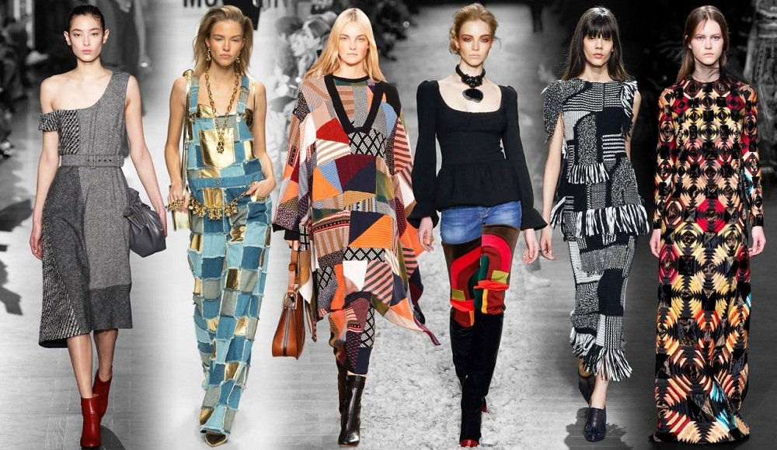
FALL/WINTER

Slide 19
FASHION LEADERS
Day.8
Fashion leaders are people who are influential in fashion. There are two main dimensions that can be seen in fashion leadership: fashion innovativeness and fashion opinion leadership. Fashion leaders are generally people who are genuinely interested in fashion for themselves and do not merely wear clothes to set trends for others.

Slide 20
FASHION VICTIMS
Day.9
A fashion victim is a person who does not dress in a way that is flattering to her. This can be because she does not pay attention to fashion and, therefore, wears old-fashioned or out-dated styles. It can also be because she doesn’t understand what works for her body type and lifestyle and ends up dressing in unflattering clothes. It might also be because she follows every fashion trend indiscriminately, without regard to whether the trend is sensible for her lifestyle or even attractive on her. Regardless of the cause, a fashion victim’s attire and appearance are unattractive, inappropriate, or both.

Slide 21
FASHION FOLLOWERS
Day.10
4 REASONS TO BECOME FASHION FOLLOWERS
The fashion follower is someone who regularly reads fashion magazines and checks trends online. He or she is keen to be seen in the latest looks and will often purchase new pieces as they hit the stores. They like to be the one who is ahead of the fashion game, probably wearing new styles before anyone else.

Slide 22
TERMINOLOGIES
Day.11
TERMINOLOGIEveryday we come across galla of terms related to fashion trade, some we know and some we don’t. We have listed down here the terminologies of fashion and their explanation.
Ex:1.Clothes :- It is a collective term for all items of apparel worn by men, women & children
2.Costumes:- The term costume can refer to wardrobe or dress of a certain period in history, people or class.

